Slide 1

Module 2.2.1
Basic Control and Vehicle Location
Montana Teen Driver Education and Training
Knowing where you are on the road

Slide 2
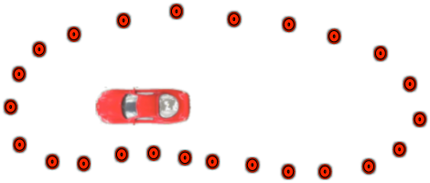
Vehicle Blind Area

Slide 3
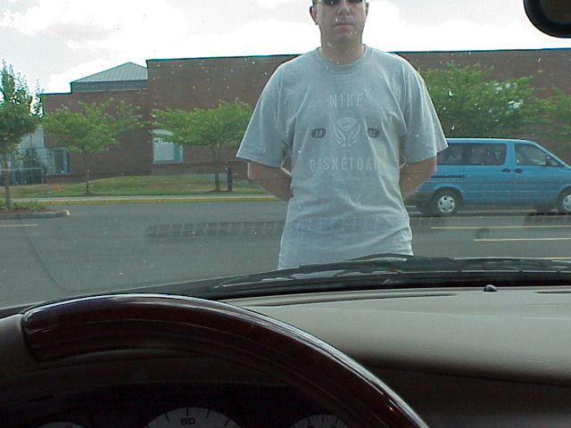
Notes:
This person is standing at the front bumper of this car. Notice that you can see nothing from the waist down because your vision is blocked by the dashboard and front of the car.

Slide 4
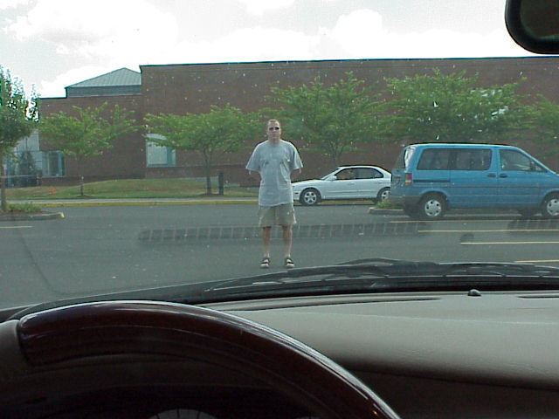
12-15 Feet
Notes:
If we back him up to where we can see him completely, we see that he has to move about 12-15 feet away from the car. We can’t see the space between the front of the car and where he stands.

Slide 5
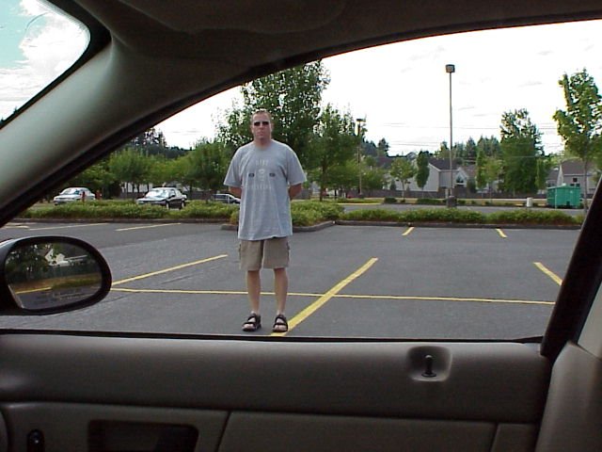
9-12 Feet
Notes:
Moving the person to passenger side of the vehicle we see that he has to move away from the car about 9-12 feet.

Slide 6
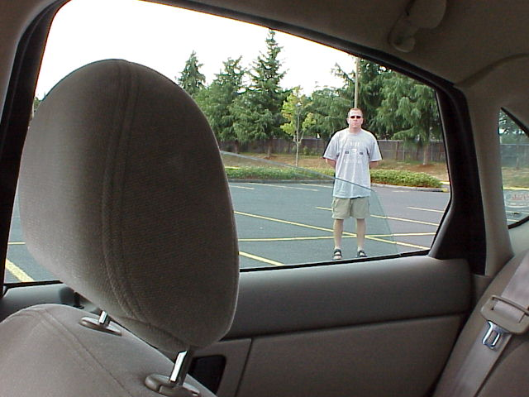
12-15 Feet
Notes:
Continuing to have him move around the vehicle we see that he has to move about 12-15 feet away from the car to be able see him completely.

Slide 7
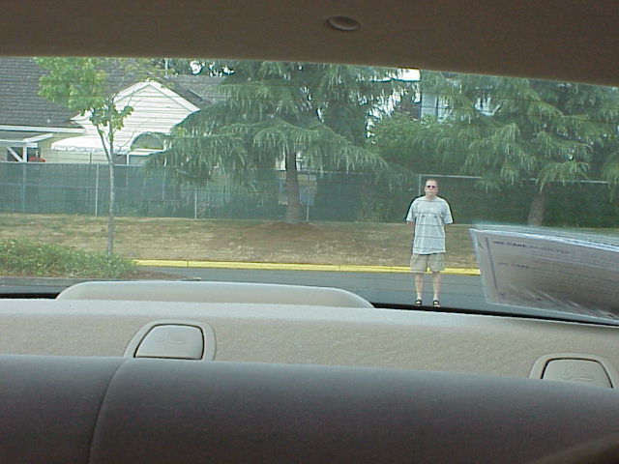
30-35 Feet
Notes:
The distance to the back is greater than the two car lengths described earlier because of modifications to the top of the back seat and the addition of head restraints to later model cars. In this particular vehicle the blind area is more than 30-35 feet, which is a considerable distance that the driver cannot see. Because most SUVs sit up higher, the visual area blocked by the vehicle is even greater.

Slide 8
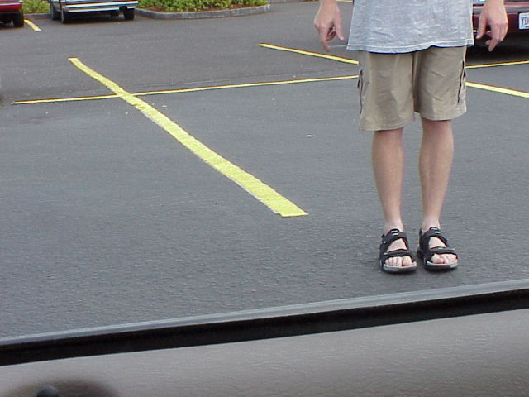
6-9 Feet
Notes:
From the driver’s side looking out to the left you have the smallest blind area of about 6-9 feet.

Slide 9
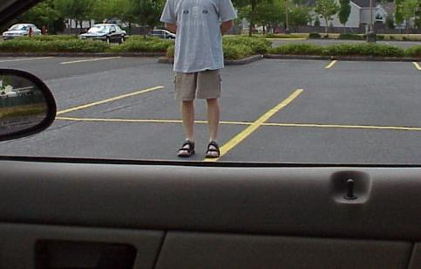
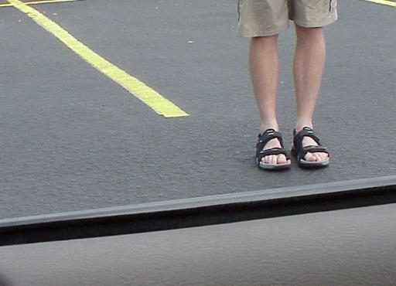
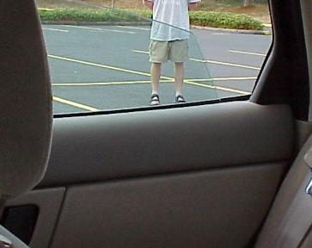
Overcoming Vehicle Blind Areas
Notes:
In the old days of driver training and instruction, knowing where a vehicle was and the space it occupied was known as fender judgment. The driver developed a sense of vehicle placement without really being able to describe how or why they knew where the car was or how close it was to other cars. With the development of reference points we can now help novice drivers develop “fender judgment” more rapidly and with more precision.

Slide 10
Purpose of Reference Points
To see some part of the vehicle as it relates to the roadway, to know where the vehicle is actually located.
To aid in parking, pulling out, navigating around other vehicles and objects.
Frederik R. Mottola©2013. Permission granted to Montana OPI.
Notes:
A reference point is seeing some part of the vehicle as it relates to the roadway and to know precisely where the vehicle is actually located. As mentioned earlier, the concept of reference points was developed by Fred Mottola of the National Institute of Driver Behaviour and has been used by drivers for many generations. There are many advantages in developing and using reference points from parking to backing, from moving to the left and right in traffic, to stopping precisely at a crosswalk or stop line. This skill is foundational to vehicle control and managing the space a car occupies.

Slide 11
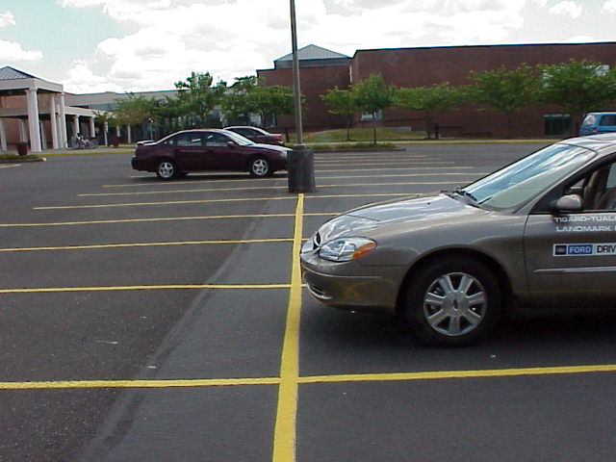
Front Limitation
Notes:
The first reference point we want to learn is the one that is associated with the front bumper of the car known as the front limitation. This reference point is used in perpendicular parking, pulling to the stop line or cross walk, pulling to the edge of the curb and myriad other applications in driving.

Slide 12
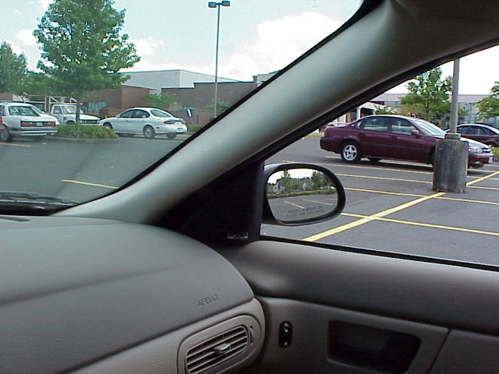
Notes:
This picture is taken from the driver’s seat at the front limit. Notice that the line appears to be entering the side of the car just under the mirror. It may look like it enters the vehicle just under the mirror or comes into the side of the mirror. What is important is that you discover where the front limitation reference point is for your vehicle and then translate that to other cars or trucks you might drive.

Slide 13
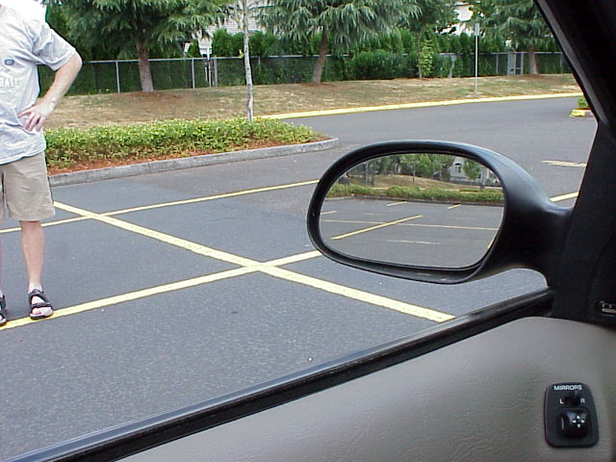
Notes:
Interestingly, note that the line appears to be coming into the same location on the driver’s side of the vehicle in the exact location as it did on the other side.

Slide 14
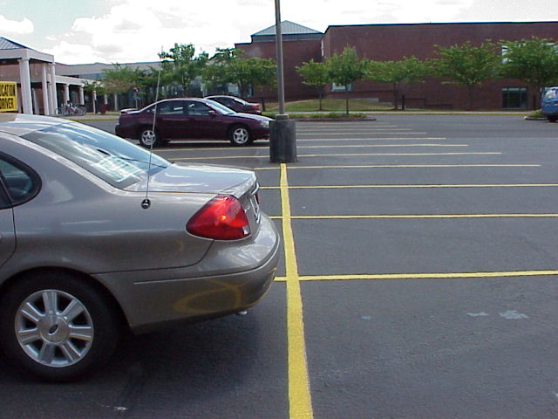
Rear Limitation
Notes:
This car is lined up with the rear bumper on a line behind the car. Since it is the rear of the car it is known as the rear limitation. It is important to know where the back of the car is when backing into a parking space.

Slide 15
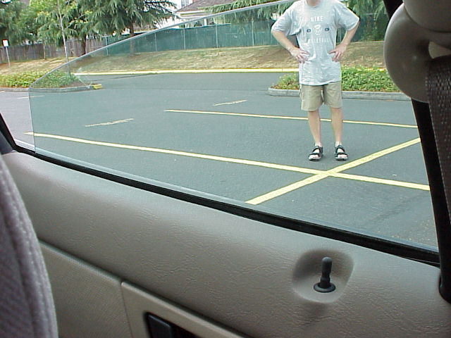
Notes:
When you are in the driver’s seat and looking over your left shoulder you will see the line appearing in the rear seat window about 12 inches behind the pillar or almost in the center of the window. With practice you can place the rear of the car within 3-6 inches of a line or curb using this reference point.

Slide 16
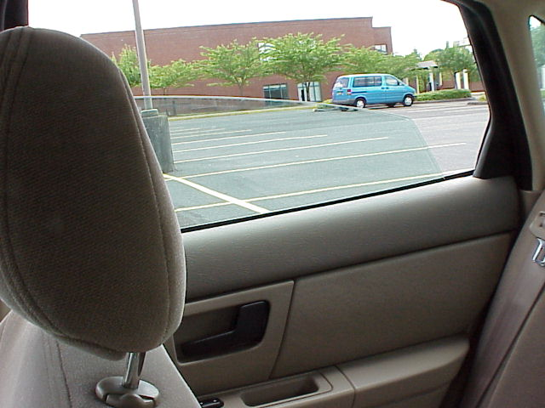
Notes:
Now look over your right shoulder between the head restraints. Notice that you can see the same reference point on the passenger side of the car. Why do you think it would be important to have a reference point on both sides of the car for both the front and the back of the car?

Slide 17
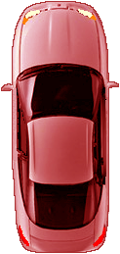
Lane Positions
Knowing where the car is on the road.
Notes:
A lane position is described as the precise location a car occupies while traveling on the road or highway. Recall that a reference point is seeing some part of the vehicle as it relates to the roadway and knowing the precise location of the vehicle. There are five specific lane positions that all drivers use. Reference points help drivers develop the ability to precisely place the vehicle in each of the 5 positions.

Slide 18
LP 1 - Lane Position One
1
Notes:
This is an overhead view of the car in LP 1. Notice that there is equal distance from either line. To help orient you to this picture, the car is moving from the left to the right.

Slide 19
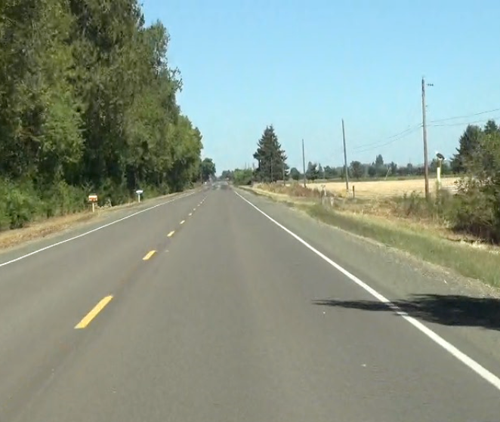
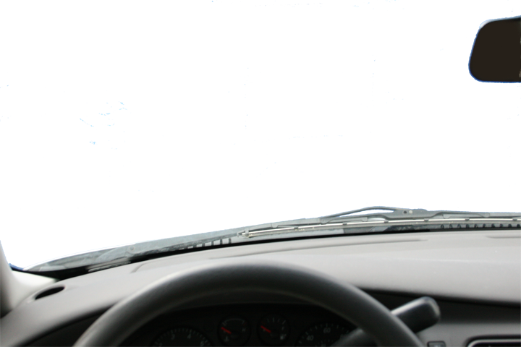
Notes:
Looking through the front window of the car we can see that the car is in lane position 1 (LP 1). We drive in LP 1 because there is no traffic to our left and no obstructions to our right. Most of our driving is done in LP 1. It gives us the freedom to move to other lane positions when traffic or obstructions present themselves.
Describe the slide and where the reference point is for LP 1. Have the students see the location of both lines on the dash by looking directly at them. Now tell them to look as far out as they can and see their target. While looking at the target ask them if they can see the reference point on the car. Practice this with each reference point slide to develop the skill of managing their lane position by keeping their eyes up and toward the target.

Slide 20
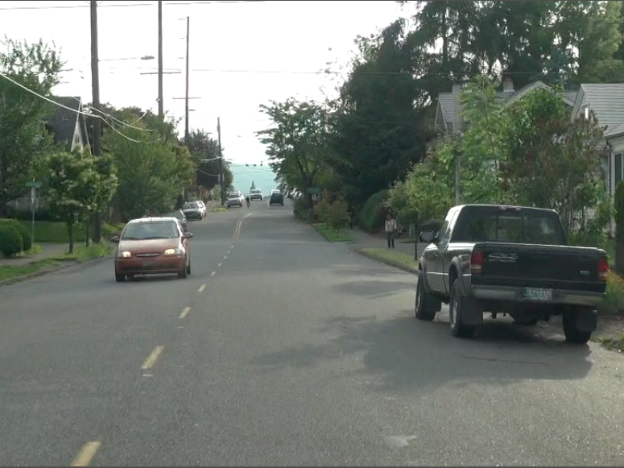
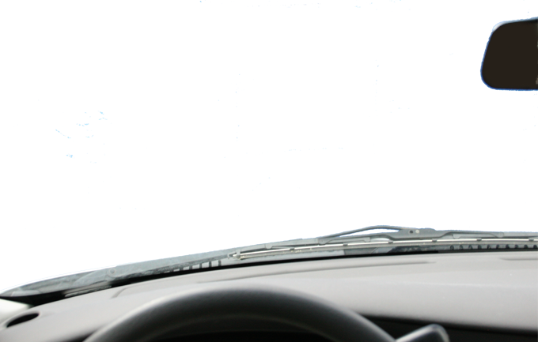
Notes:
This driver has only one lane position available to them. They have to be in LP 1 to create equal space from the approaching car and the parked car. Even though this presentation is about lane position it is an important concept to include a brief discussion about speed control here. Since the only lane option for this driver is LP 1, prudence dictates that the best speed control option for this driver is to slow down to minimize risk.

Slide 21
Lane Position One Applications
Normal driving conditions
Keep space between the car, on-coming traffic and objects on the right.
Notes:
LP 1 is used in most driving situations. Our roads are between 10-12 feet wide and most cars are a little over 6 feet wide. In LP 1 you effectively have about 3-4 feet on either side of the vehicle.
When centered in the middle of the road the driver creates space between their car, oncoming traffic, and objects on the right side of the road.

Slide 22
LP 2 - Lane Position Two
2
Notes:
Lane position 2 is about 3-6 inches from the center line of the road.

Slide 23
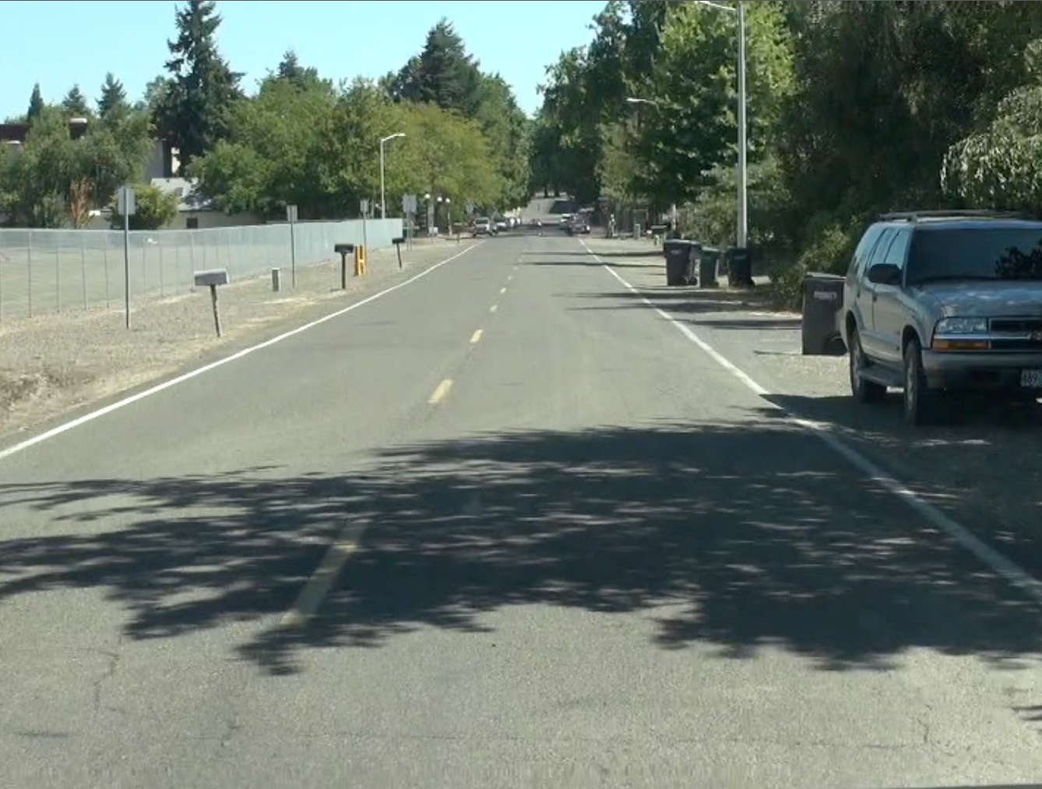
Notes:
Here we see the center line appear to enter the car about 12 inches from the corner post. We normally don’t drive in LP 2 because it puts us closer to oncoming traffic and increases our risk of a crash. We use LP 2 to create space between POT blockages. The right front area of our car has a car parked there and we move over to LP 2 to create more space to move safely around the parked car.

Slide 24
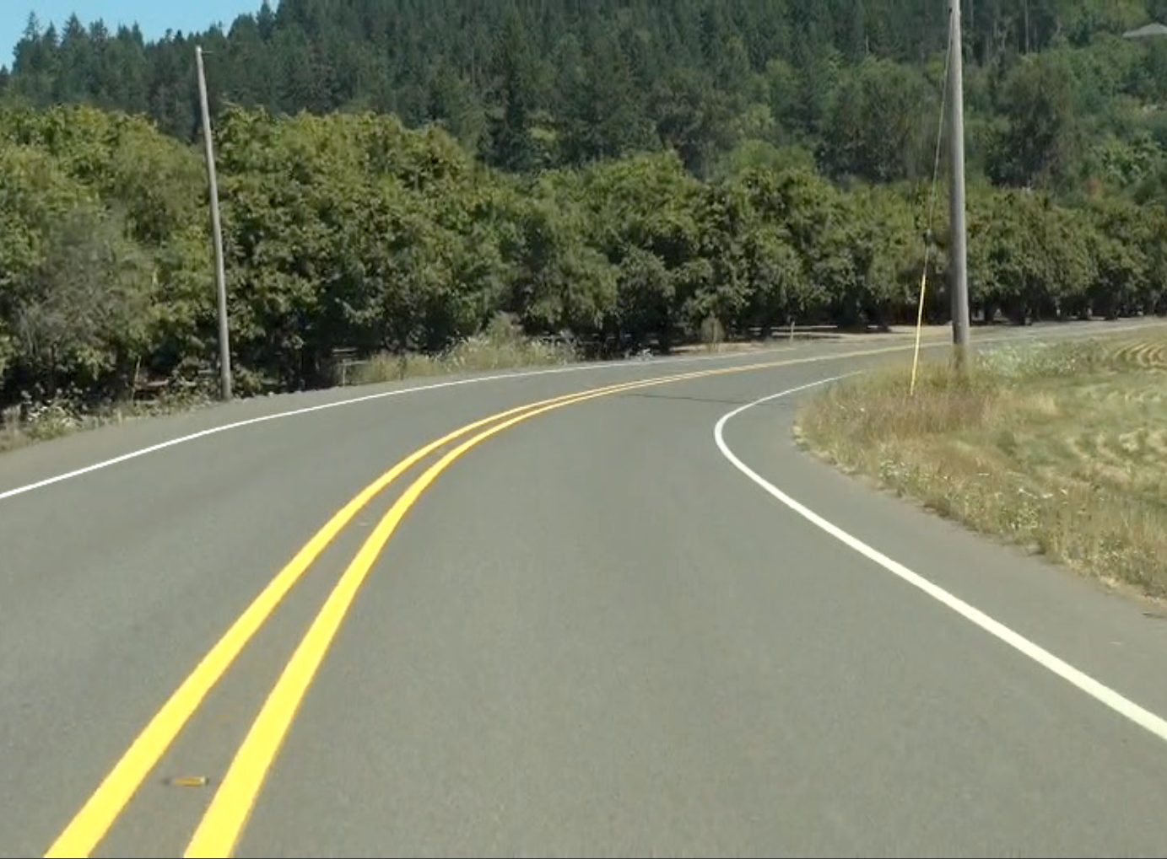
Notes:
LP 2 is used in this case to set up for a curve to the right. Moving to LP 2 when there are no oncoming cars serves two purposes. The first is to establish an effective driveline through the curve which helps keep the car in balance. The second is to help the driver see more effectively around the right hand curve. If there were a bush or building blocking the driver’s view around the curve, the driver can increase her line of vision around the curve by moving toward the center line to LP 2.
Do the lane position activity here but this time you will notice that there is no target. That’s because we don’t target in a curve. The driver must look as far through the curve as possible. In this case it is to the edge of the photo. Can the driver still see the LP 2 reference point with their fringe vision?

Slide 25

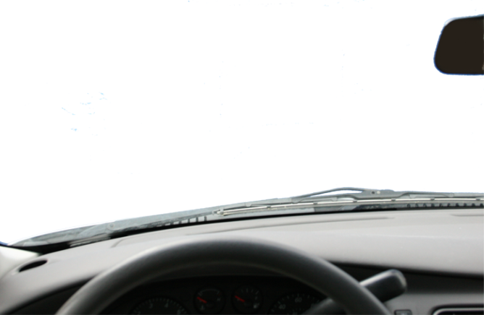
Lane Position 2 Applications
Improves your line of vision
Creates space
Sets up your driveline
Notes:
Improves your line vision around a right hand curve
Creates space between your car and an object on the side of the road
Sets up your driveline through a right hand curve

Slide 26
LP 3 - Lane Position Three
3
Notes:
Lane position 3 is toward the right lane edge usually marked with a solid white line or the shoulder of the road with no lines.

Slide 27
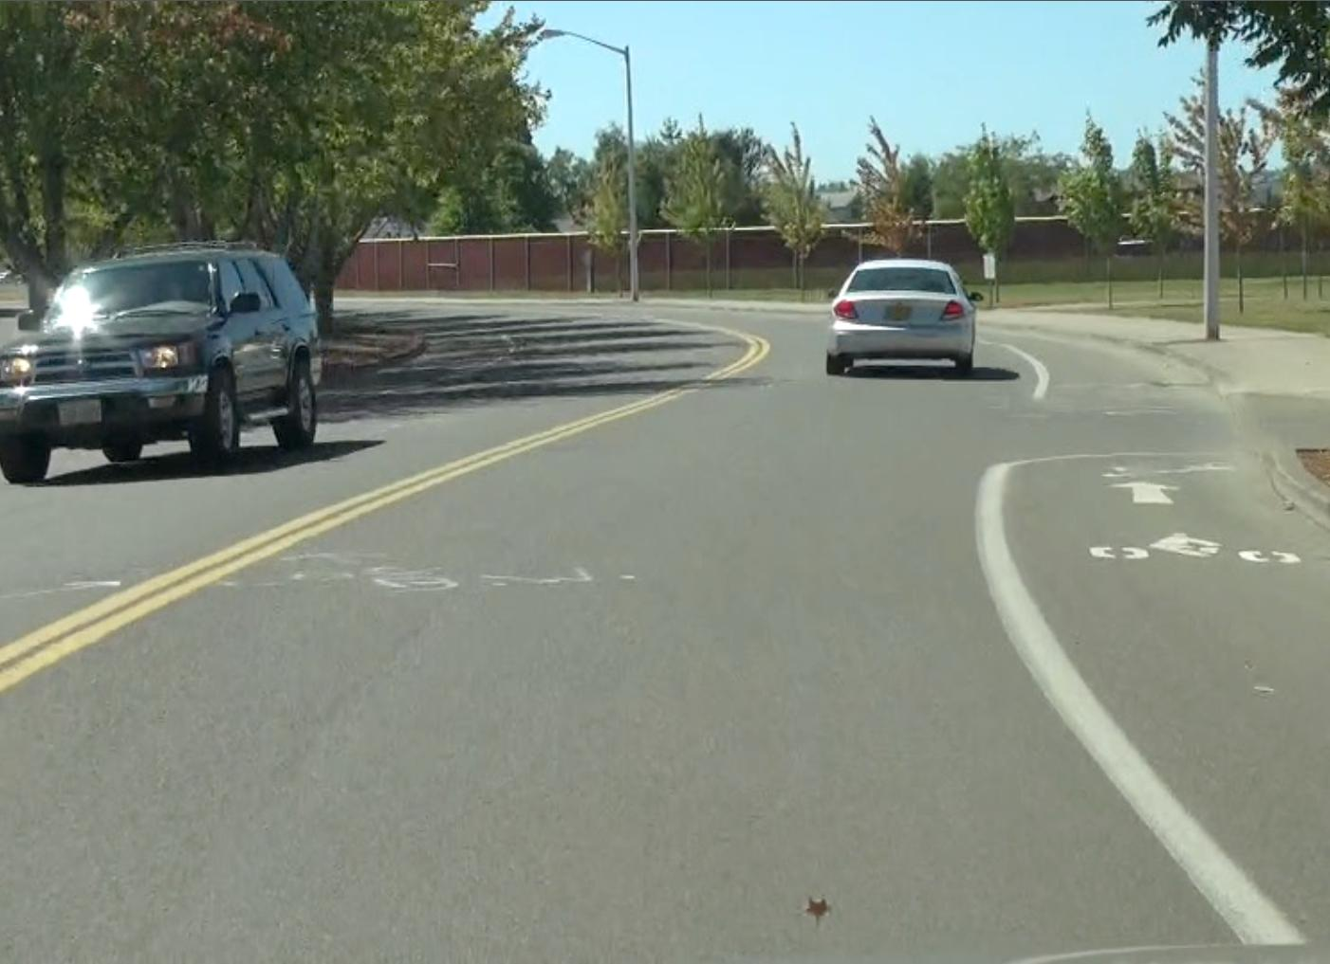
Notes:
This driver is in LP 3 for three reasons. The first is to create space between her car and the approaching car. The second is to improve her drive line through the curve and set her up for the next curve. The third is to increase her line of vision around those trees on the left in the next curve.

Slide 28
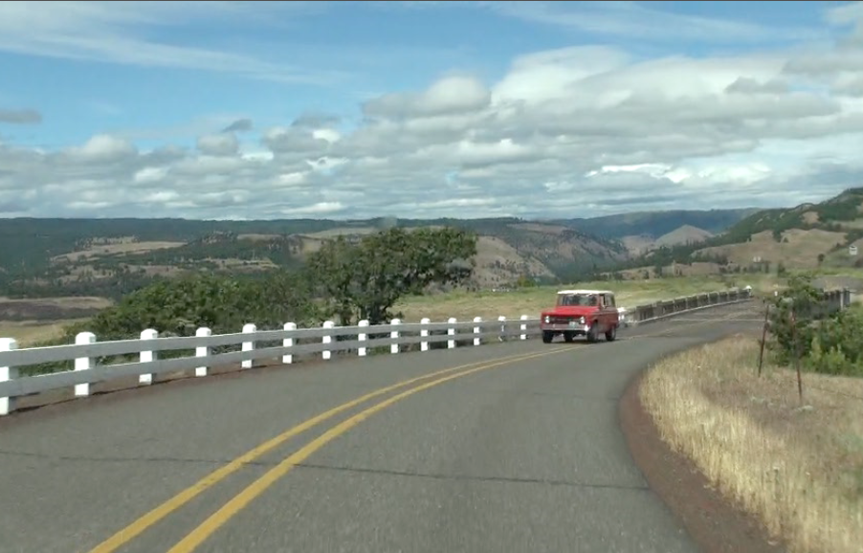
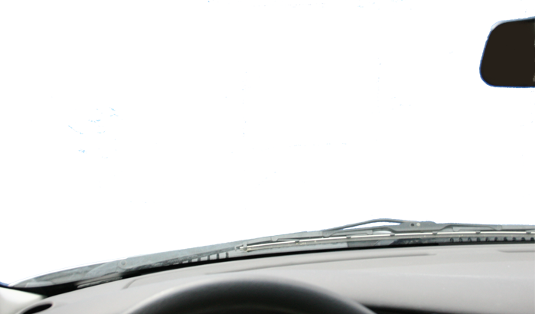

Slide 29
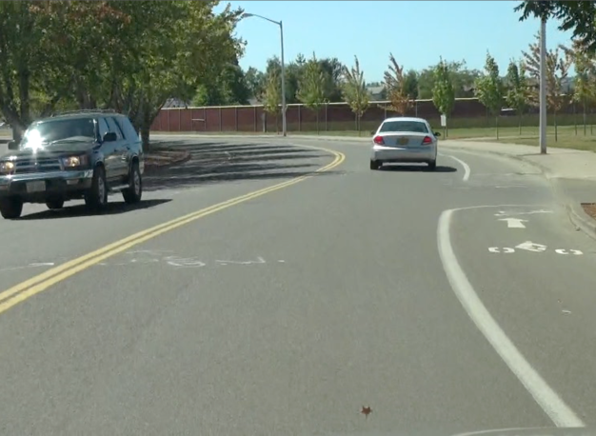
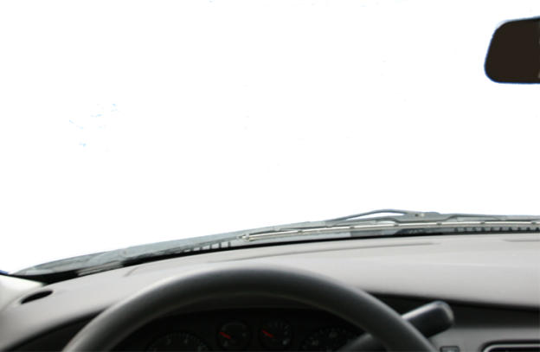
Lane Position 3 Applications
Improves your line of vision
Creates space
Sets up your driveline
Notes:
Improves your line vision around a left hand curve
Creates space between your car and an oncoming car or oversized load—farm equipment, oil drilling rigs, or manufactured homes in transport
Sets up your driveline through a left hand curve

Slide 30
LP 4 - Lane Position Four
4
Lane positions 4 and 5 straddle a line to avoid a problem.
Notes:
Lane position 4 is technically not a true lane position because we can’t continue to travel in this position for any length of time except to pass an obstruction or make a lane change. Lane positions 4 and 5 straddle the line to avoid a problem. In this diagram, we see the car in Lane Position 4 straddling the center line.

Slide 31
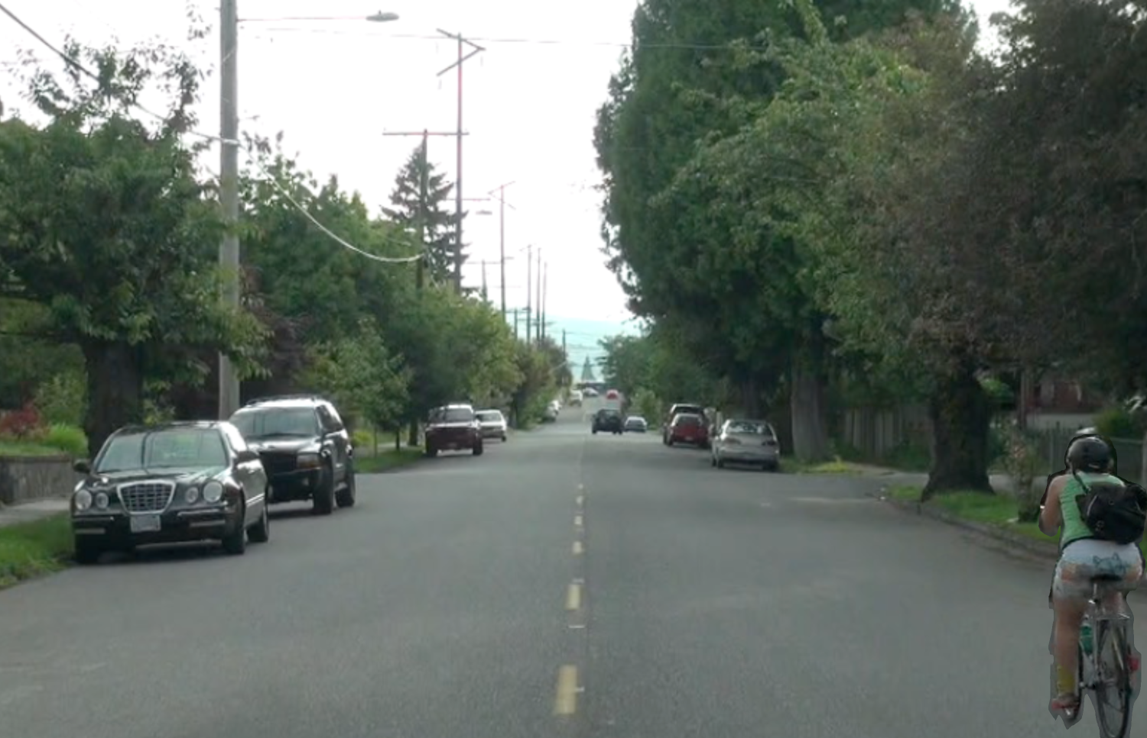
Notes:
This picture shows the view from the driver’s perspective as the driver passes a bicyclist on the right. We can only use LP 4 when there is no oncoming traffic or the traffic is far enough away that there is time to make the pass.
When the driver looks up at the target can they still see the bicyclist and their lane position? Have the students look to the target and describe to their partner what they see with their other vision.

Slide 32
LP 5 - Lane Position Five
5
Notes:
Lane position 5 positions the car straddling the lane edge marker.

Slide 33
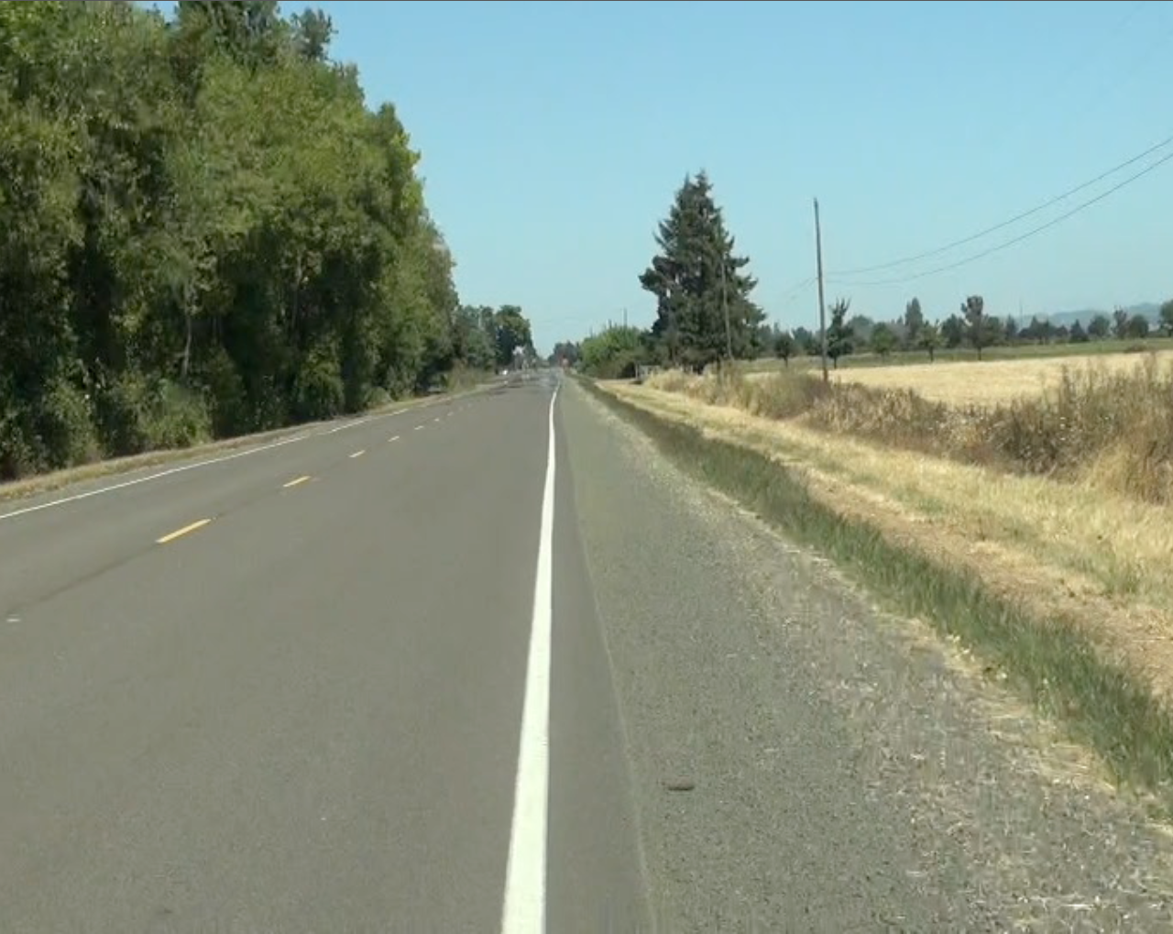
Notes:
Lane position 5 is used to move over and allow others to pass or to create space for an oversize load coming from the opposite direction. It is also used to move over for emergency vehicles.

Slide 34
Lane Position Options
4
2
1
3
5
Notes:
Lane positions 1, 2, 3, 4 and 5 each have important applications to driving. Knowing how and why to precisely place the car on the roadway will help the novice driver develop their “fender judgment” sooner and help them manage the myriad risks they will encounter over a lifetime of driving.

Slide 35
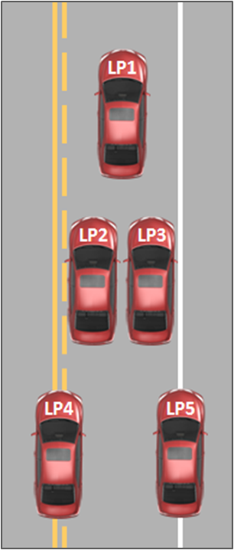
Student Activity 1
View the next ten slides.
You are sitting in the driver’s seat.
You will see a photo appear from the inside of the car. Your job is to identify your lane position.
Look at the photo and then show your lane position choice by holding up your hand with correct number of fingers.

Slide 36
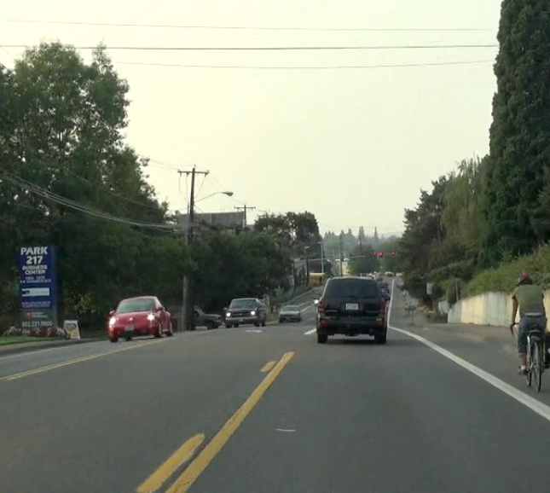
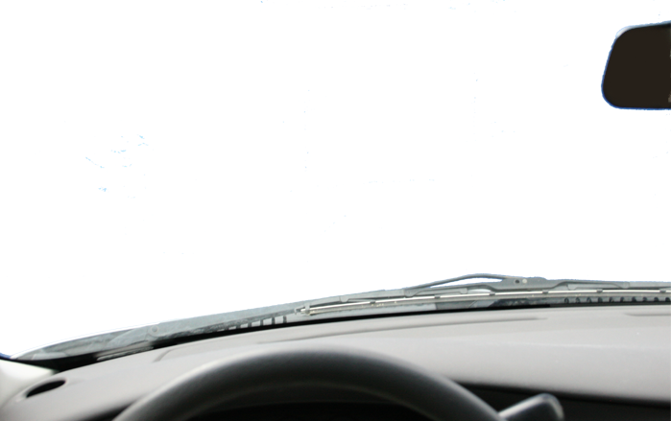

Slide 37
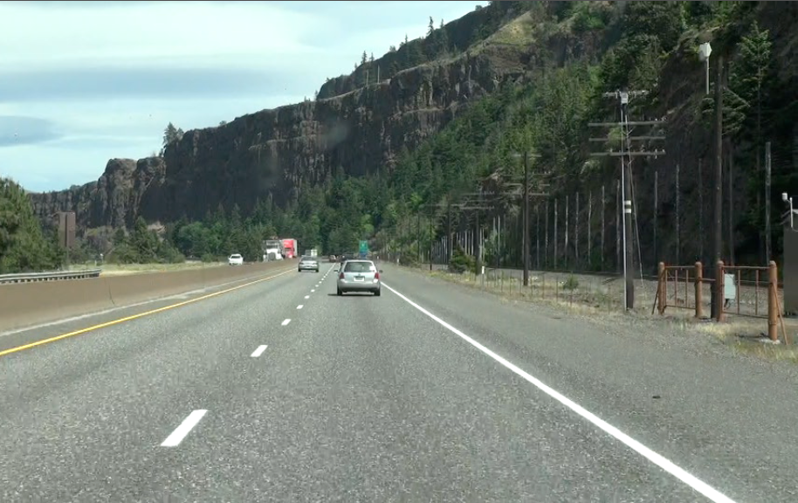

Slide 38
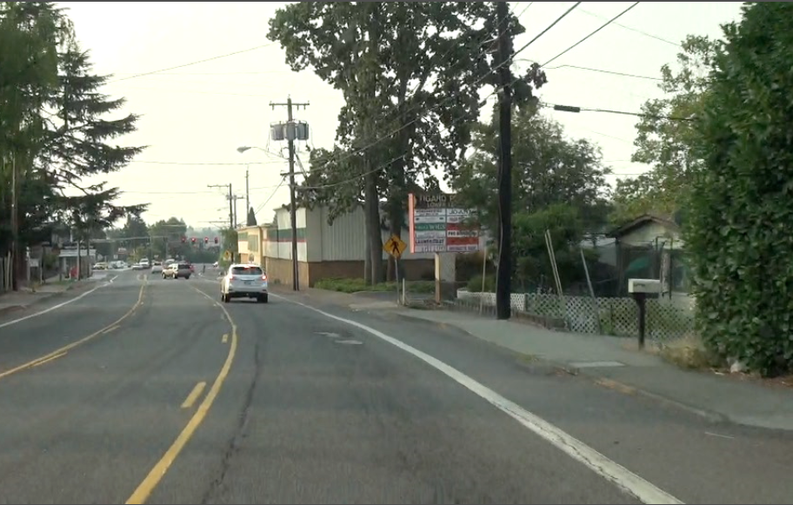

Slide 39
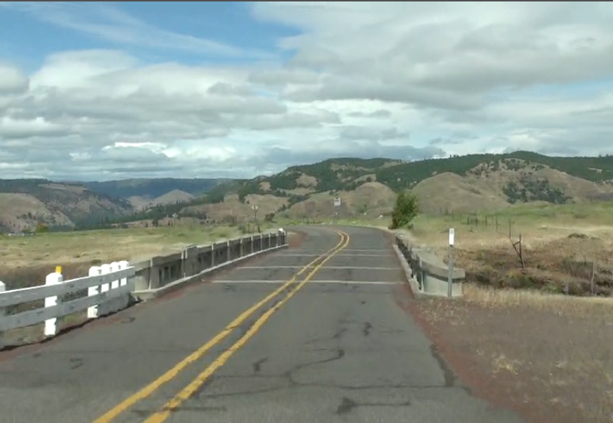

Slide 41
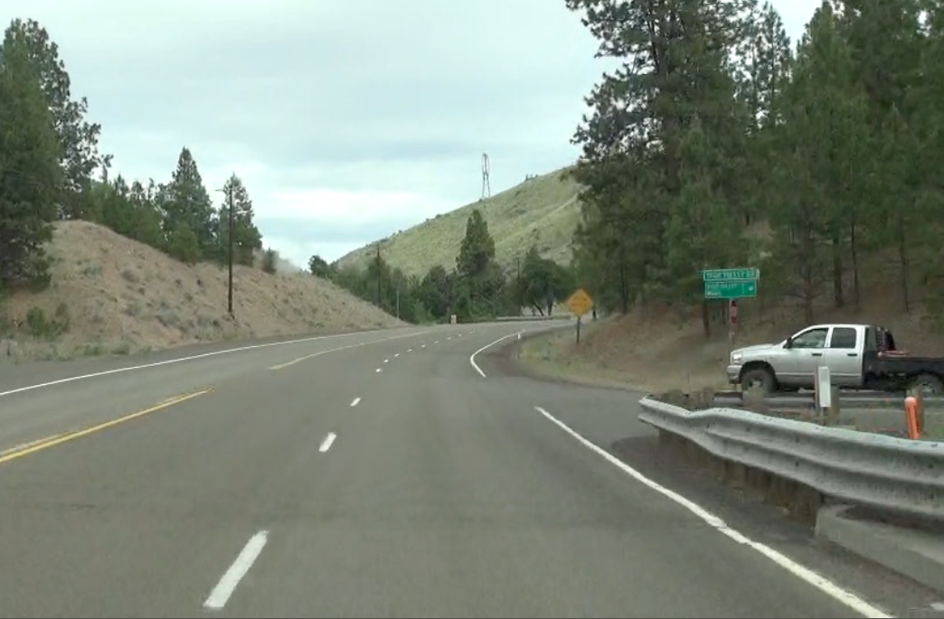
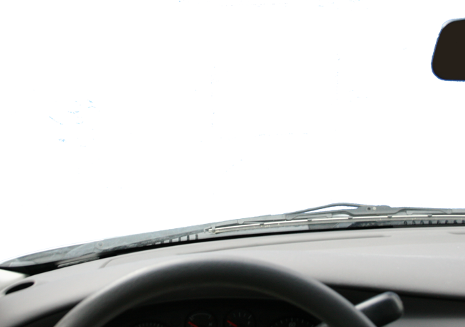

Slide 42
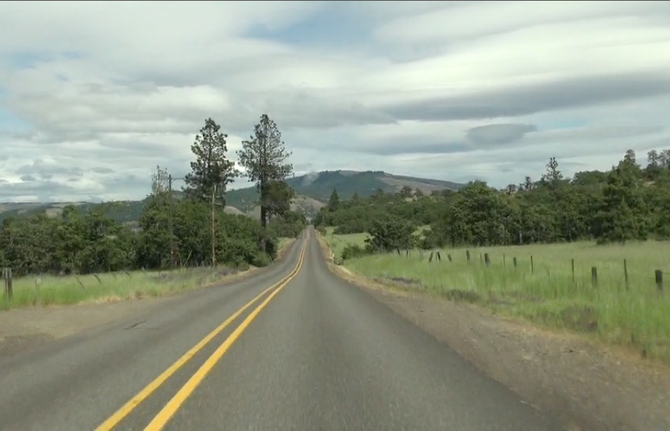

Slide 43
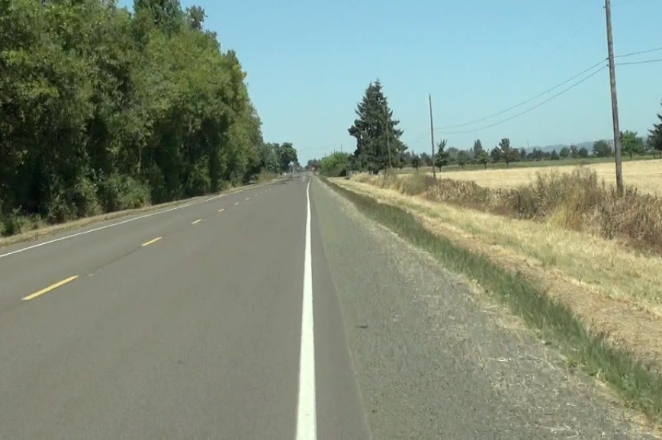

Slide 44
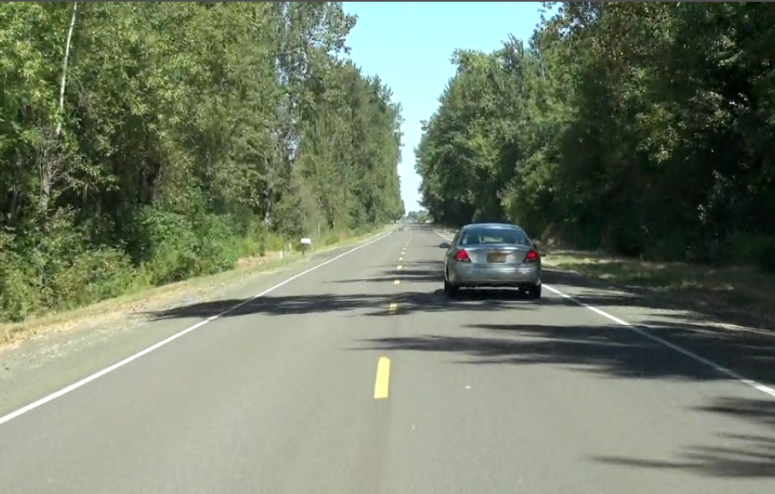

Slide 45
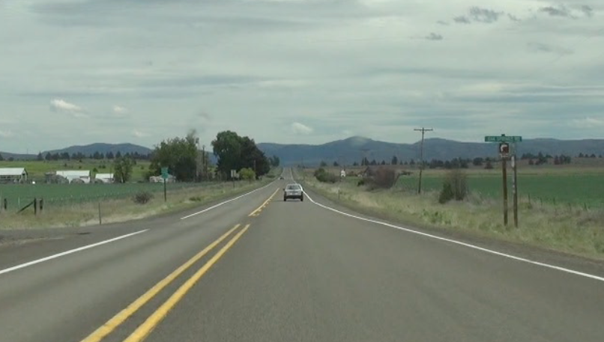

Slide 46

Entering Traffic Safely
VIDEO: Entering Traffic
Notes:
Here are the proper procedures for entering traffic from a parked vehicle on the side of the road.

Slide 47
Montana Driver Education and Training
Standards and Benchmarks
1. Laws and Highway System
  1.1. know the laws outlined in the Montana Driver's manual;
  1.2. understand the laws outlined in the Montana Driver's Manual; and
  1.3. consistently demonstrate knowledge and understanding by responsible adherence to highway transportation system traffic laws and control devices.
2. Responsibility
  2.1. recognize the importance of making safe and responsible decisions for owning and operating a motor vehicle;
  2.2 demonstrate the ability to make appropriate decisions while operating a motor vehicle;
  2.3. consistently display respect for other users of the highway transportation system; and
  2.4. develop positive habits and attitudes for responsible driving.
3. Visual Skills
  3.1. know proper visual skills for operating a motor vehicle;
  3.2. communicate and explain proper visual skills for operating a motor vehicle;
  3.3. demonstrate the use of proper visual skills for operating a motor vehicle; and
  3.4. develop habits and attitudes with regard to proper visual skills.
4. Vehicle Control
  4.1. demonstrate smooth, safe and efficient operation of a motor vehicle; and
  4.2. develop positive habits and attitudes relative to safe, efficient and smooth vehicle operation.
5. Communication
  5.1. consistently communicate driving intentions (i.e., use of lights, vehicle position, and personal signals);
  5.2. adjust driver behavior based on observation of the highway transportation system and other roadway users;
  5.3. adjust communication (i.e., use of lights, vehicle position, and personal signals) based on observation of the highway transportation system and other users; and
  5.4. develop positive habits and attitudes for effective communication.
6. Risk Management
  6.1. understand driver risk-management principles;
  6.2. demonstrate driver risk-management strategies; and
  6.3. develop positive habits and attitudes for effective driver risk-management.
7. Lifelong Learning
  7.1. identify and use a range of learning strategies required to acquire or retain knowledge, positive driving habits, and driving skills for lifelong learning;
  7.2. establish learning goals that are based on an understanding of one’s own current and future learning needs; and
  7.3. demonstrate knowledge and ability to make informed decisions required for positive driving habits, effective performance, and adaptation to change.
8. Driving Experience
  8.1. acquire at least the minimum number of BTW hours over at least the minimum number of days, as required by law, with a Montana-approved driver education teacher; and
  8.2. acquire additional behind-the-wheel driving experience with a parent or guardian’s assistance in a variety of driving situations (i.e., night, adverse weather, gravel road, etc.).
Notes:
Standards and Benchmarks: This is for your reference and not to be read to the class verbatim. Please review prior to the lesson so you are aware of what the student will be required to know at the end of the module.

